Slide 1
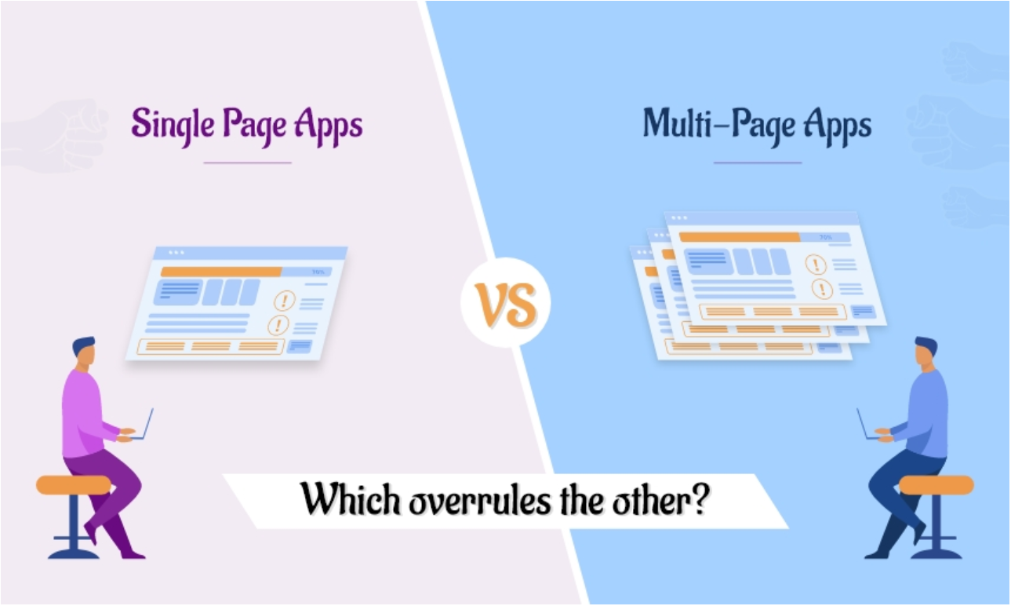
MPA vs. SPA

Slide 2
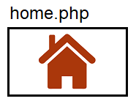







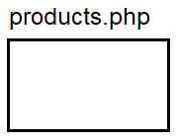

Multi Page Application
Frontend
Backend
Page
Page
Page

Slide 3
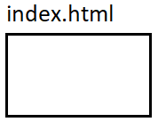





Single Page Application
Frontend
Backend
Empty Page
REST API
JSON

